Slide 1
Master Slave Configuration USING TEAM
Bhargavi Bairagoni
Vasanthi Tugunturi
Balaji Bathala
Vamsi

Slide 2
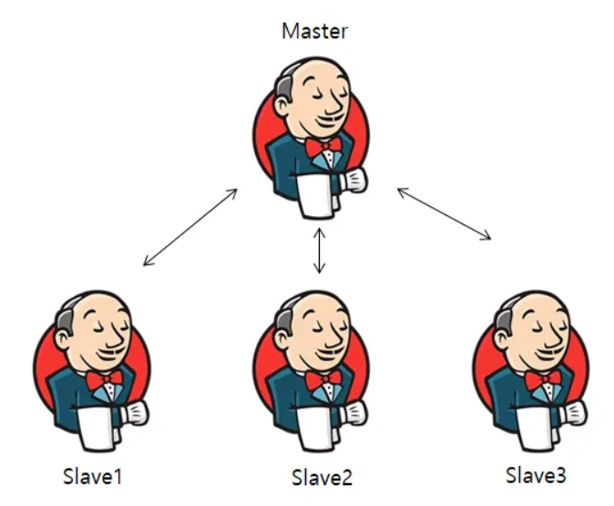
Agenda
Set up master slave configuration using same account and different account.
Slave-1 Node (Deploy WordPress with Kubernetes).
Slave-2 Node (Deploy WordPress with Docker Compose).
Slave-3 Node (Deploy WordPress with Terraform).
Slave-4 Node (Deploy WordPress with Poll-SCM, Build Periodically, Webhooks).
Slave-5 Node (Deploy WordPress with Bash Script).

Slide 3
Master Slave Configuration
The terms master and slave describe the roles of systems or nodes in a setup, where one system (the master) controls or manages the other systems (the slaves)
Master:
The master is the central control system that manages and coordinates the tasks or processes. It directs the actions of the slave nodes, distributes workloads, and often serves as the point of configuration or management. In cloud environments, the master can manage other nodes, handle requests, and oversee the deployment of software or services.
Slave:
A slave node is subordinate to the master node. It follows the instructions given by the master node. Each slave node can perform tasks like running a specific service or handling a portion of the load, such as hosting a web application like WordPress.

Slide 4
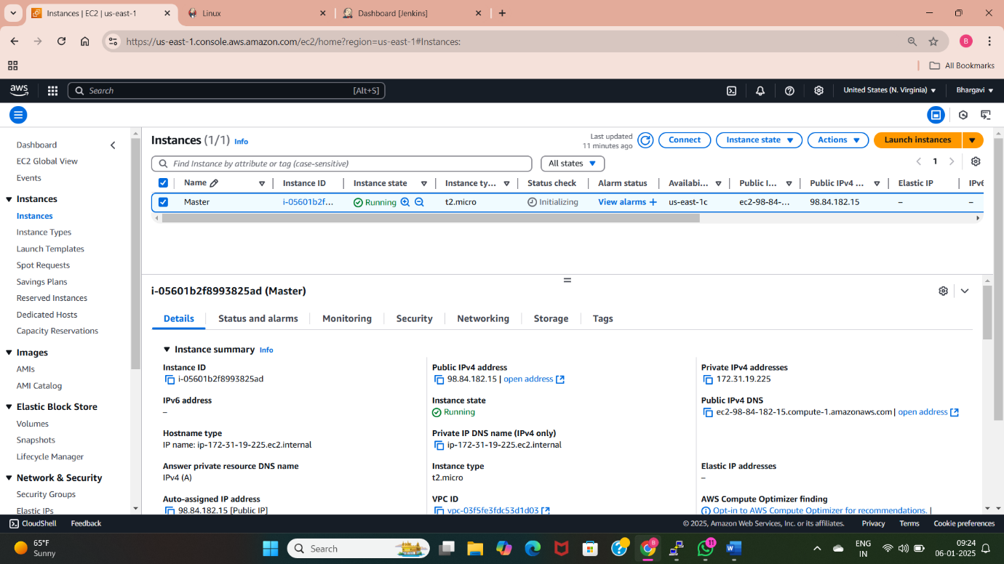
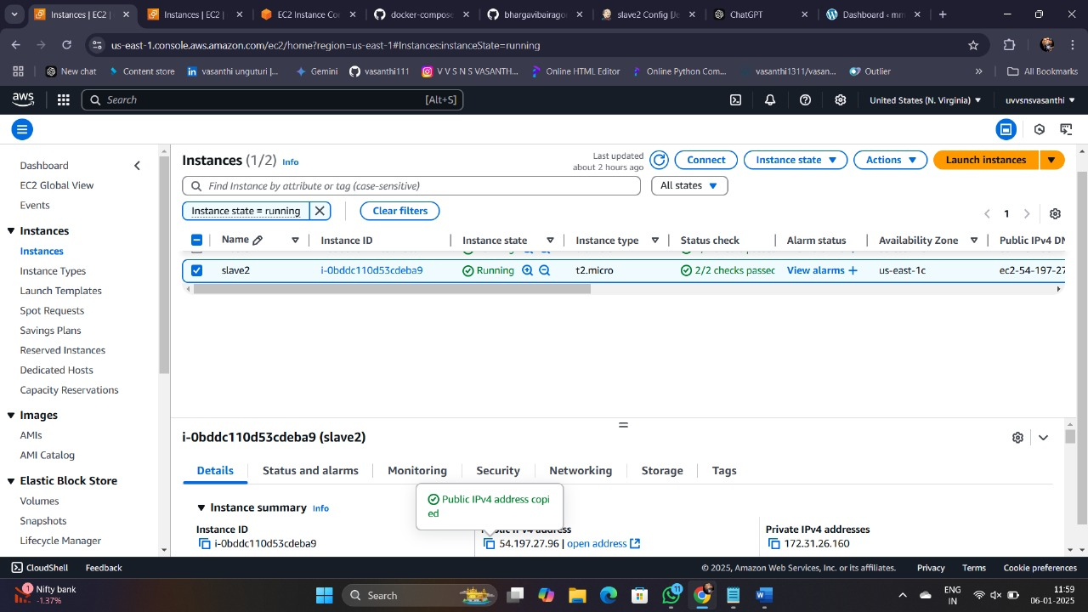
Master Slave Configuration using different account
Create master server in one account.
Install and set up Jenkins and required plugins.
Share the Jenkins url with team.
Launch slave servers in different accounts and connect with master.
Install Jenkins dependency in every slave node.

Slide 5
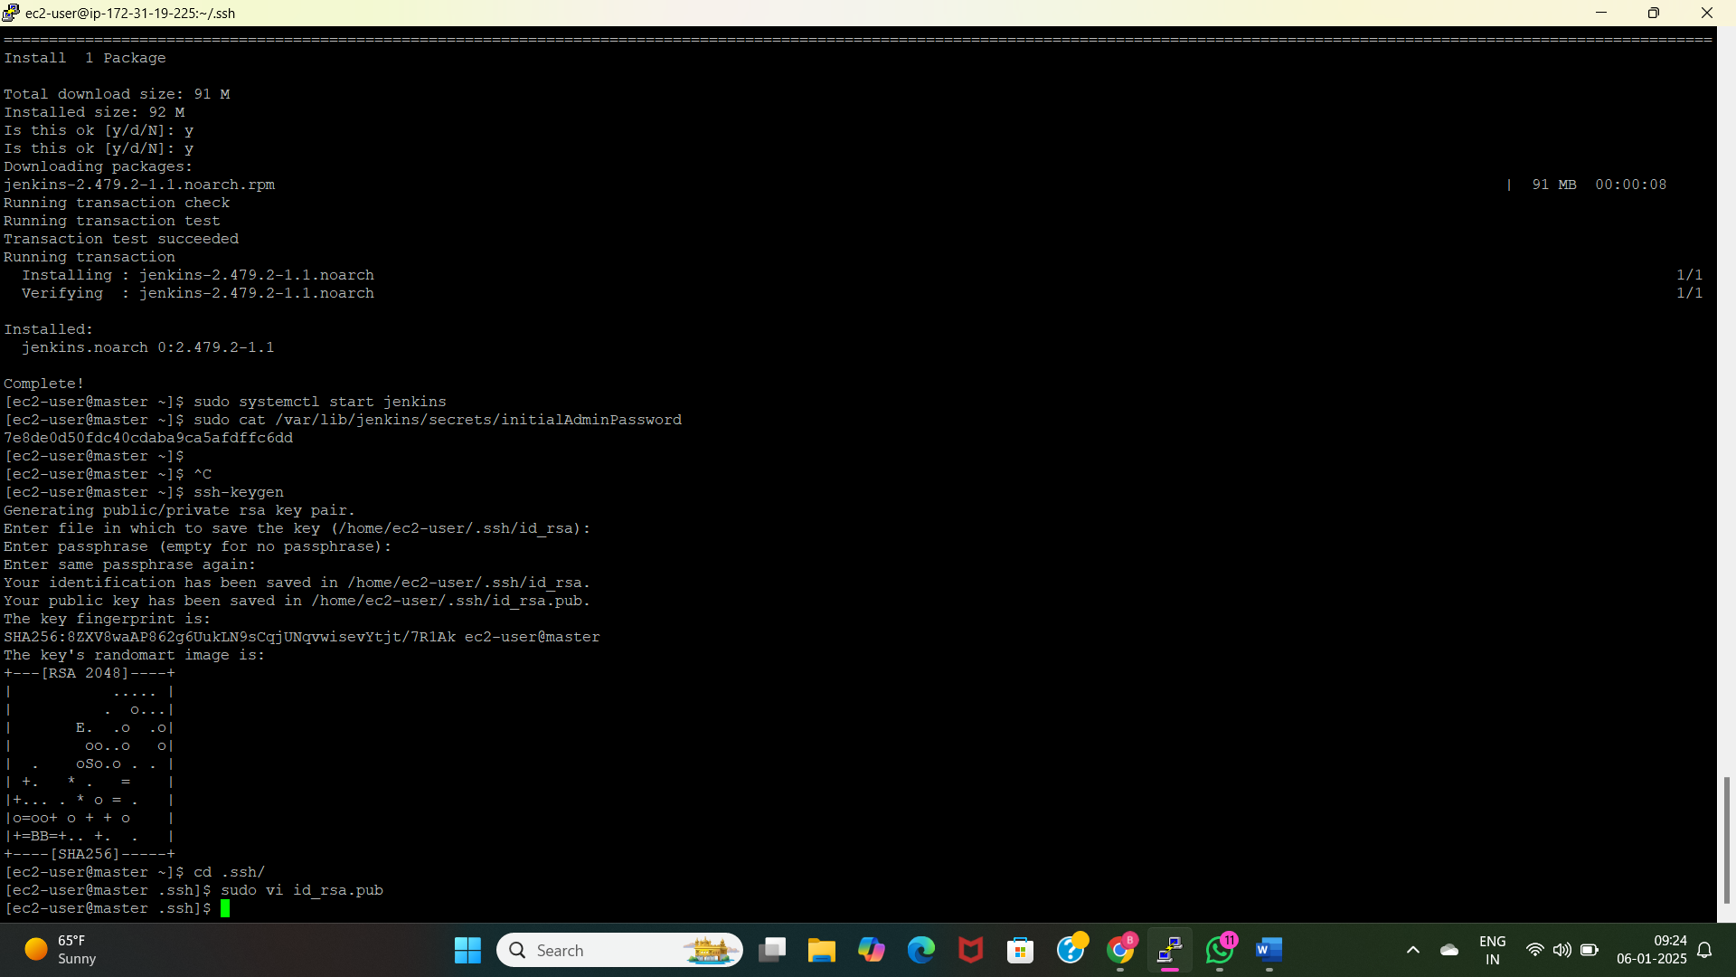
Slave1: Deploy wordpress using k8s
Launch slave1 server in vamsi account.
Connect this server with master with public key of master(Bhargavi account).
Create slave1 node using Jenkins with public host.
Create a job using slave1 node and install kops, kubectl and create clusters.
Write the deployment and service files and execute the files.

Slide 6
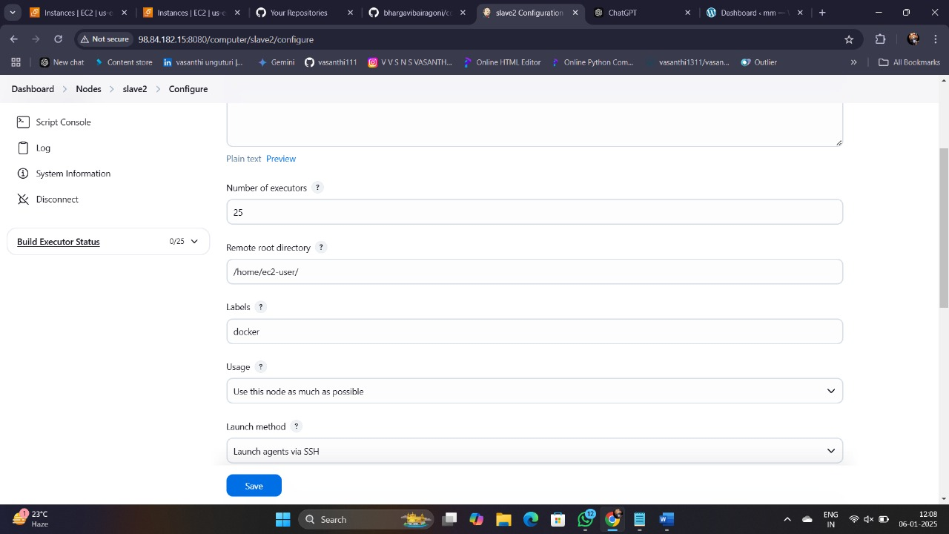
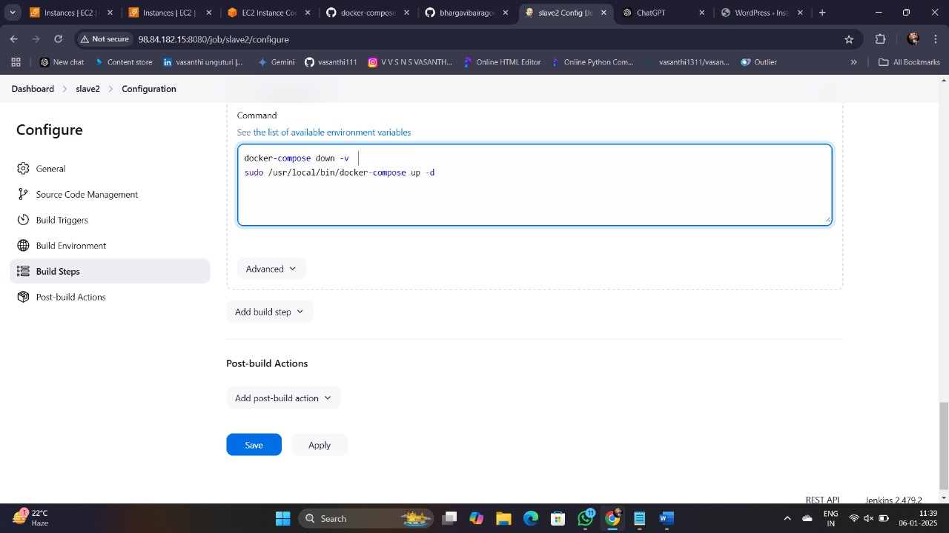
SLAVE2 : DEPLOY WORDPRESS APPLICATION USING DOCKER COMPOSE
Launching a slave2 server in vasanthi account.
Create slave2 node.
Assign the Label to Slave2.
Install docker, docker-compose in slave2
Write execution commands in shell.
Execute the builds
Verify the application deployment.
Access application using public ip address of slave2 instance.

Slide 7
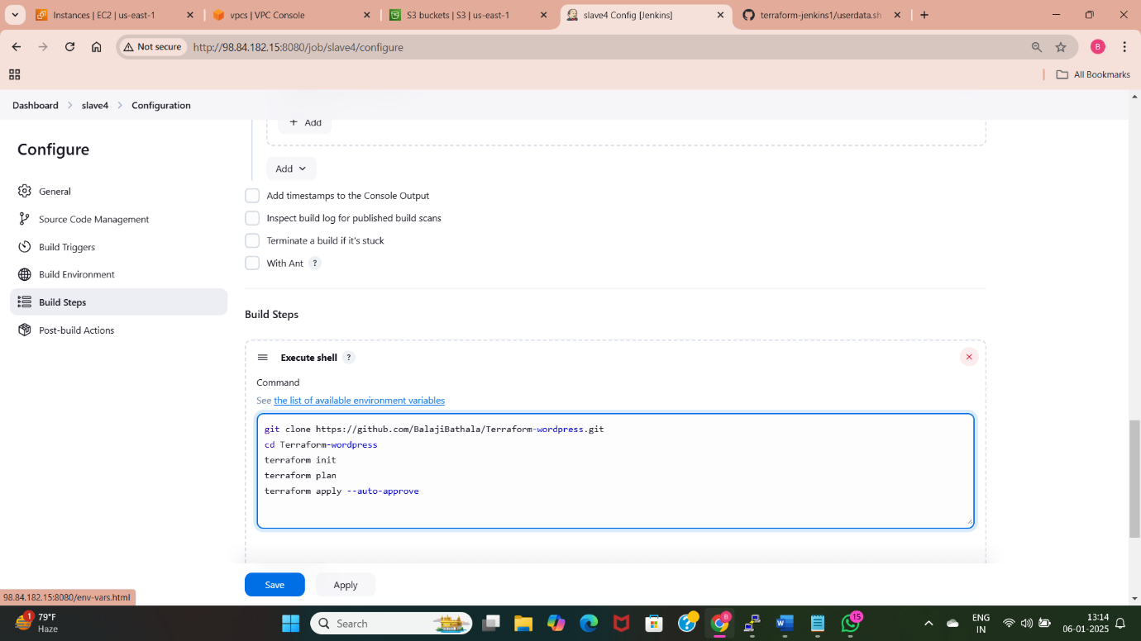
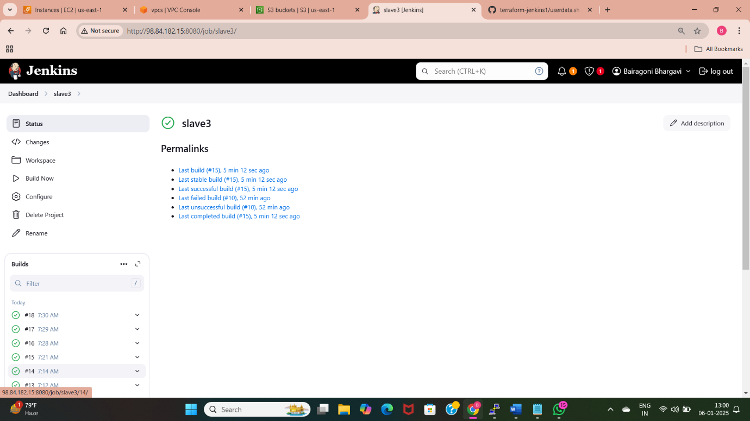
Slave3: manually Deploy wordpress using terraform files
Launch Slave3 Server in Balaji Account.
Create Slave3 Node.
Assign the Label to Slave3.
Install Terraform on Slave3.
Write Execution Commands for Terraform in Shell.
Execute Terraform Deployment.
Verify Application Deployment.
Access Application via Public IP Address of Slave3 Instance .

Slide 8
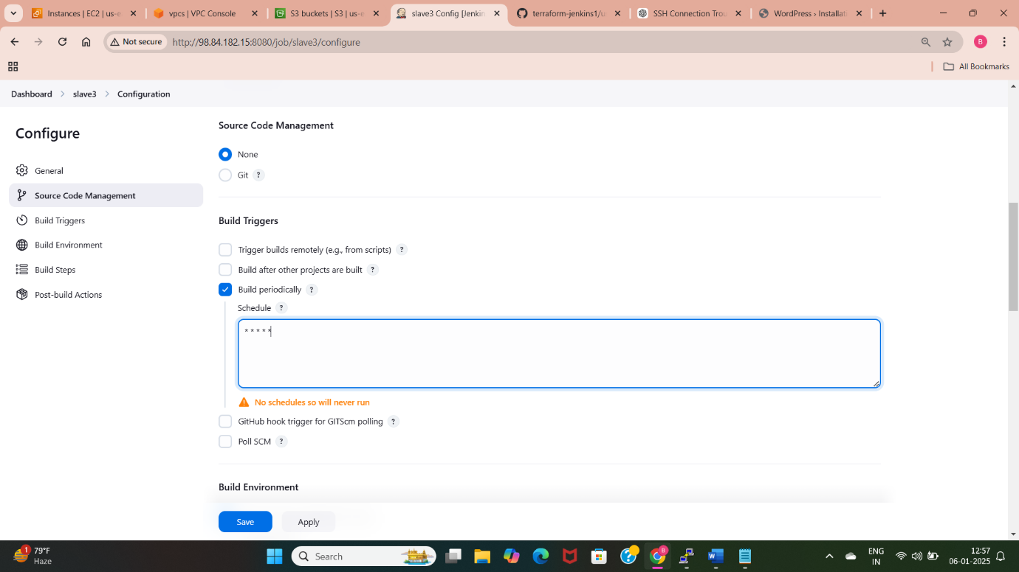
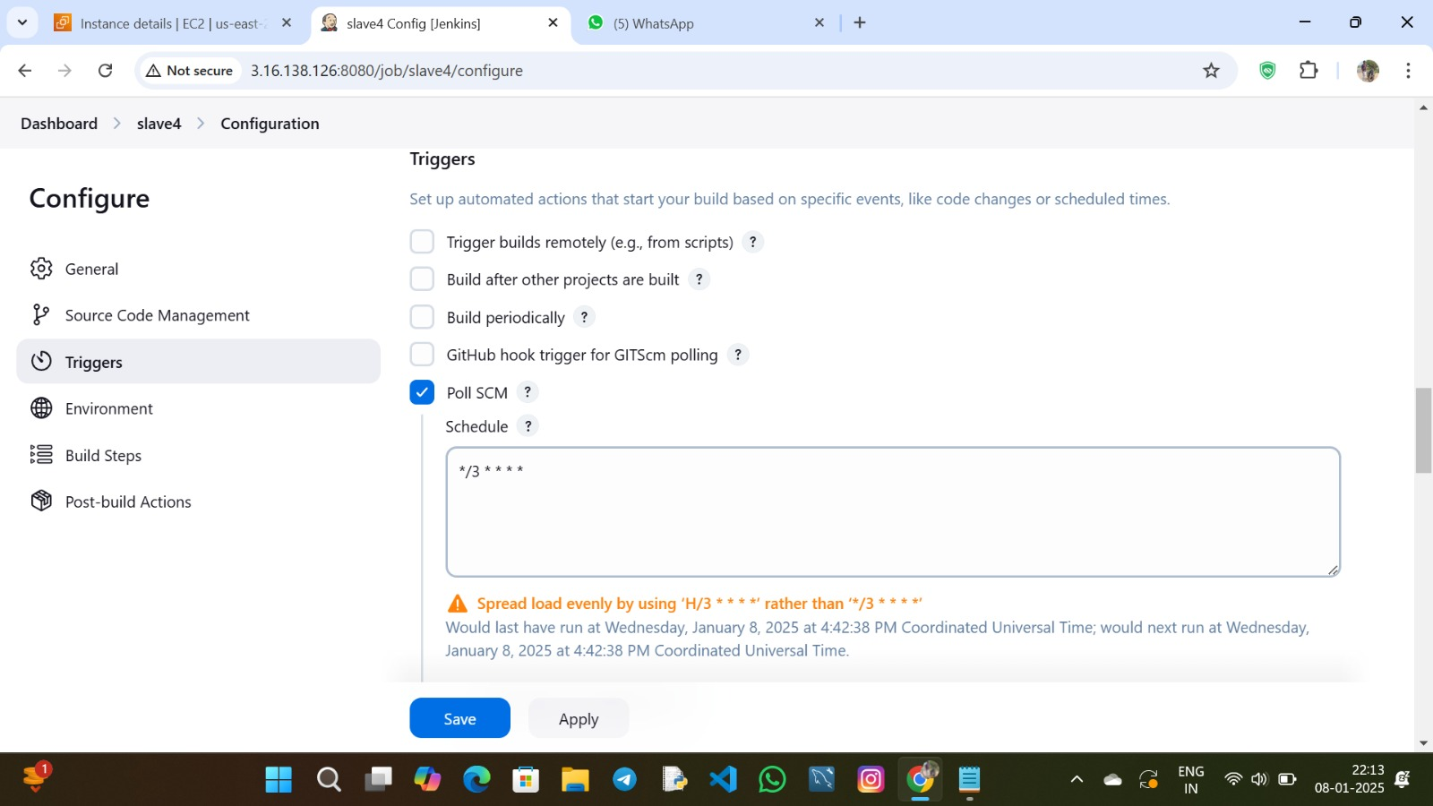
Slave4: Automatically Deploy wordpress using terraform
Launch Slave4 Server in Balaji Account.
Create Slave4 Node.
Assign the Label to Slave4.
Install Poll-SCM and Configure Webhooks.
Set Up Build Periodically Configuration.
Write Execution Commands in Shell.
Execute the Builds.
Verify Application Deployment.
Access Application via Public IP Address of Slave4 Instance.

Slide 9
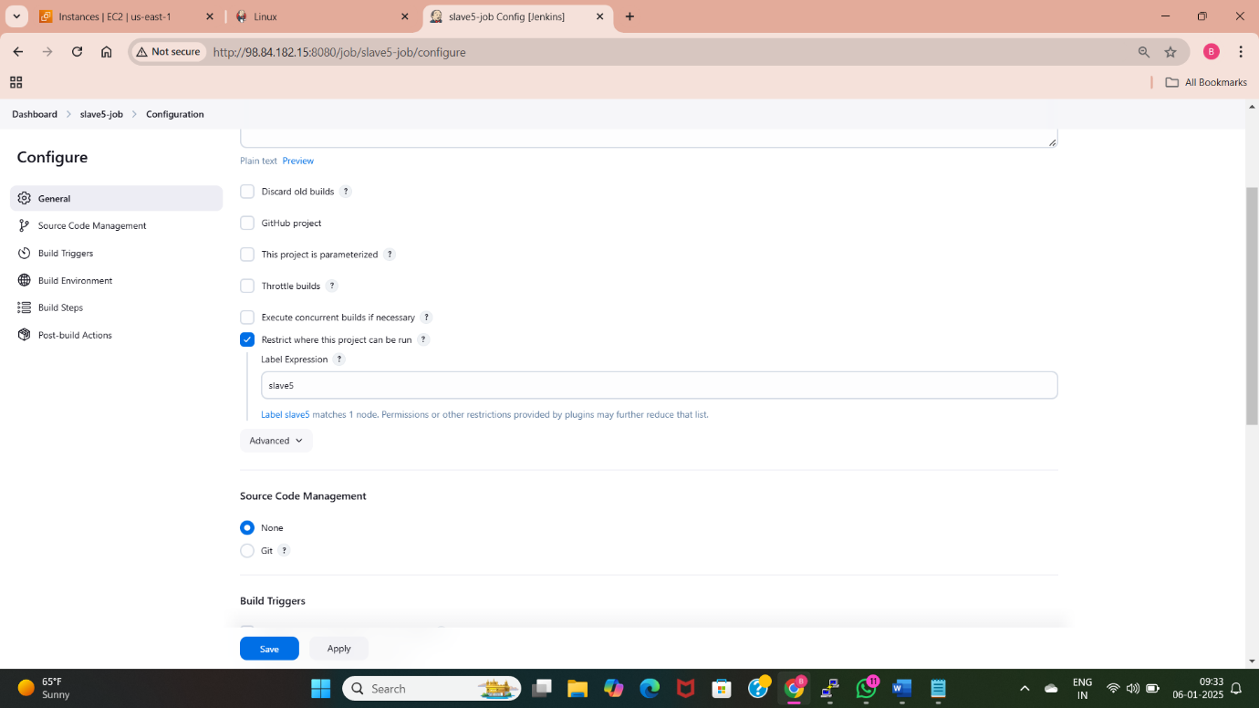
Slave5: Deploy wordpress using kubernetes
Launch Slave5 Server in Bhargavi Account.
Create Slave5 Node.
Assign the Label to Slave5.
Install Bash Script for WordPress Deployment.
Write Execution Commands in Shell for WordPress Deployment.
Execute the WordPress Deployment via Bash Script.
Verify Application Deployment.
Access Application via Public IP Address of Slave5 Instance

Slide 10
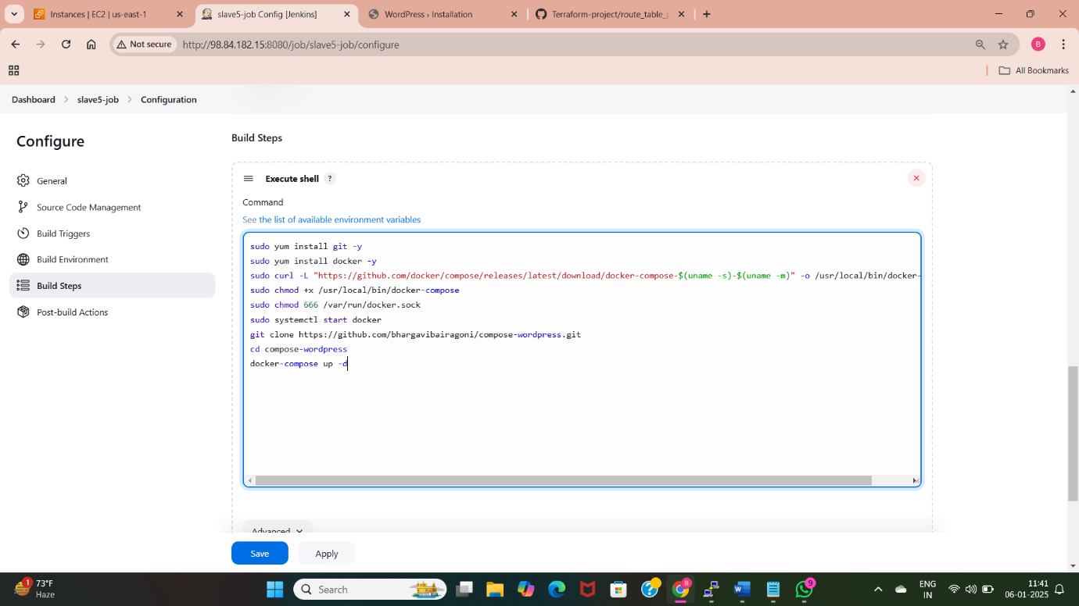
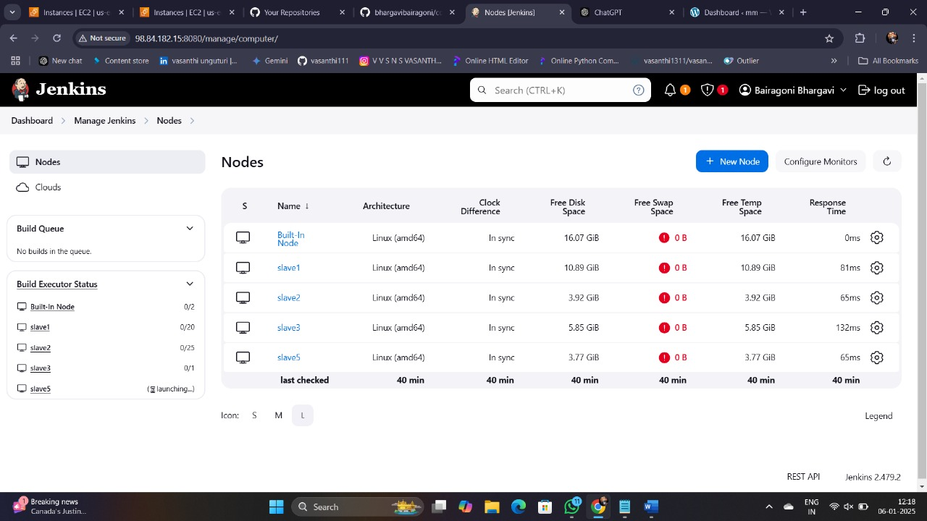

Slide 11
MASter slave configuration in same account
Launch Master Node.
Configure Master and slave Node with AWS Credentials.
Launch Slave Servers in the Same AWS Account.
Connect Slave Nodes to Master.
Assign Labels to Slave Nodes.
Install Required Tools (e.g., Docker, Terraform, Kubernetes) on Slave Nodes.
Set Up Build Configurations on Master Node.
Execute Builds Across Slave Nodes.
Monitor and Verify Deployment

Slide 12
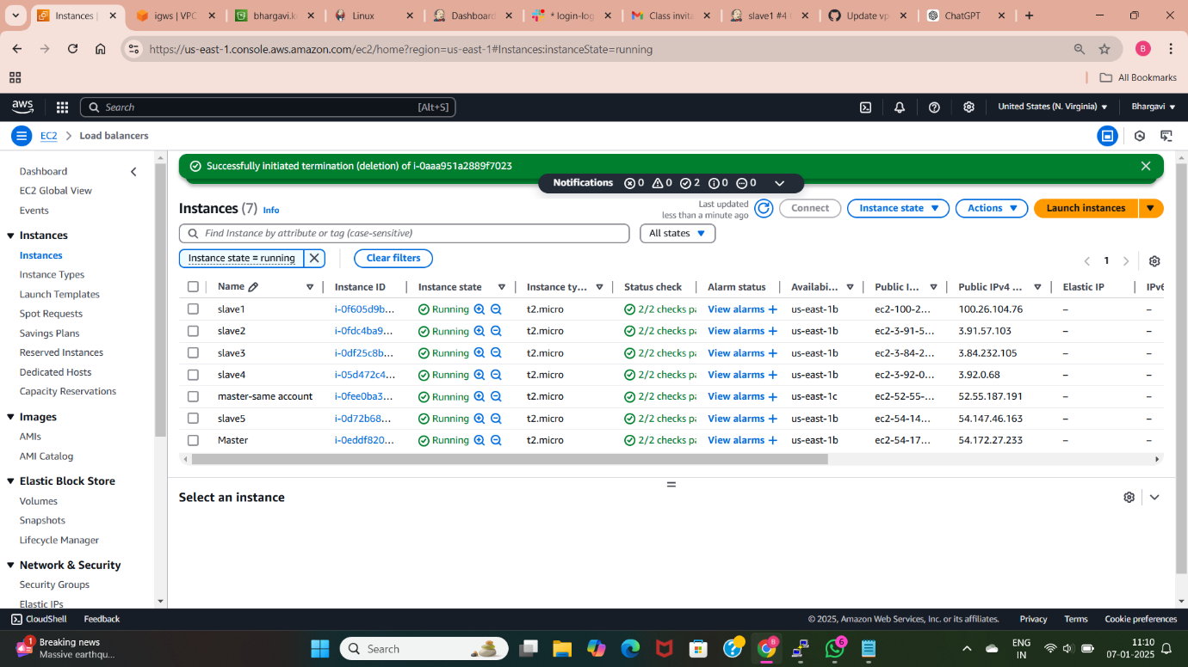
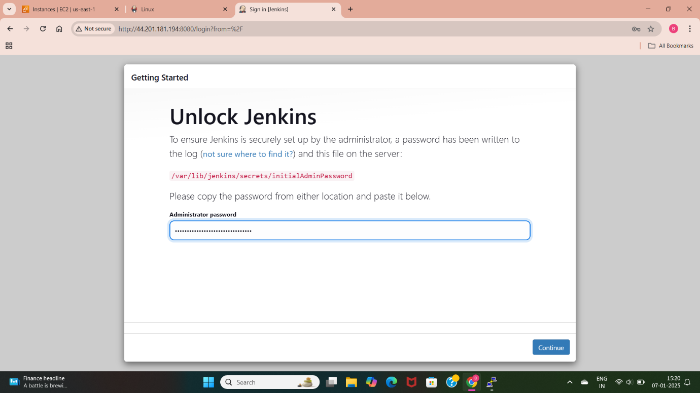
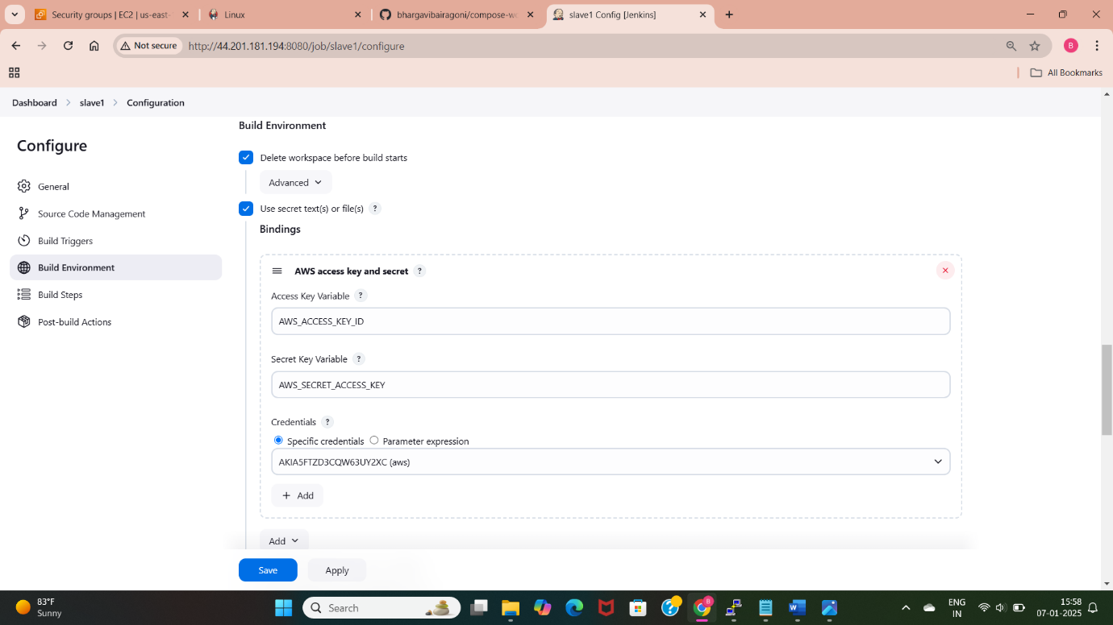

Slide 13
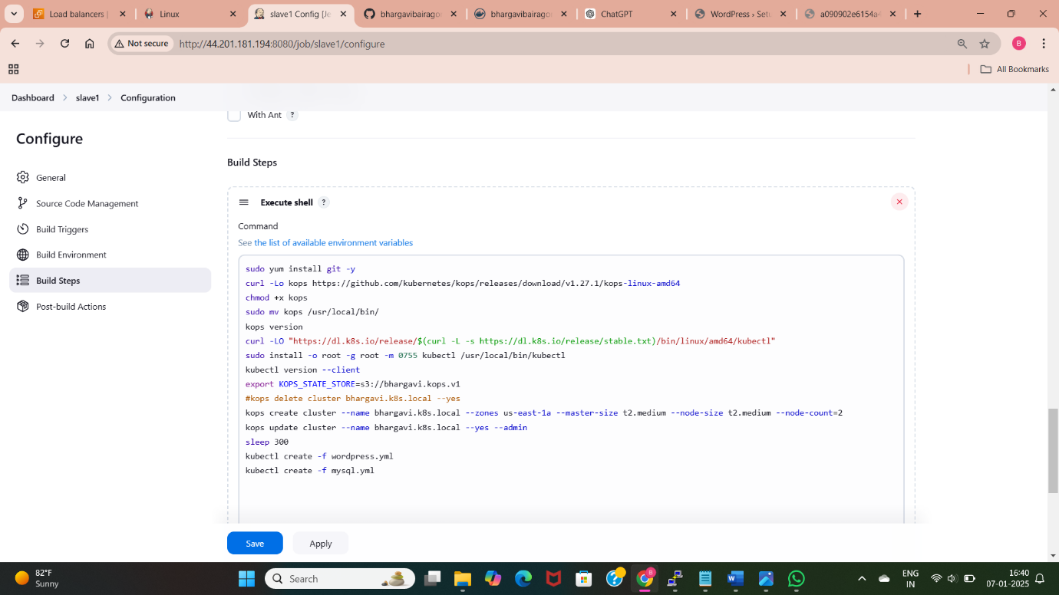
Slave1
Kubernetes (often abbreviated as K8s) is an open-source container orchestration platform that automates the deployment, scaling, and management of containerized applications. It is designed to help developers efficiently manage complex, distributed systems.
Launch Slave1 Server in the Same AWS Account.
Create Slave1 Node.
Assign the Label to Slave1.
Install Kubernetes on Slave1.
Write Execution Commands for WordPress Deployment Using Kubernetes.
Execute the Kubernetes Deployment.
Verify Application Deployment.
Access Application via Public IP Address of Slave1 Instance .

Slide 14
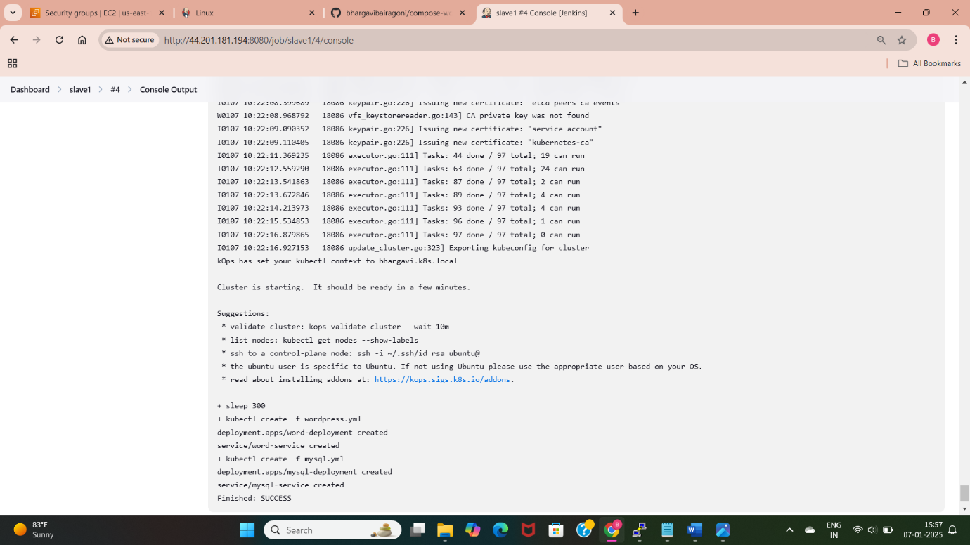
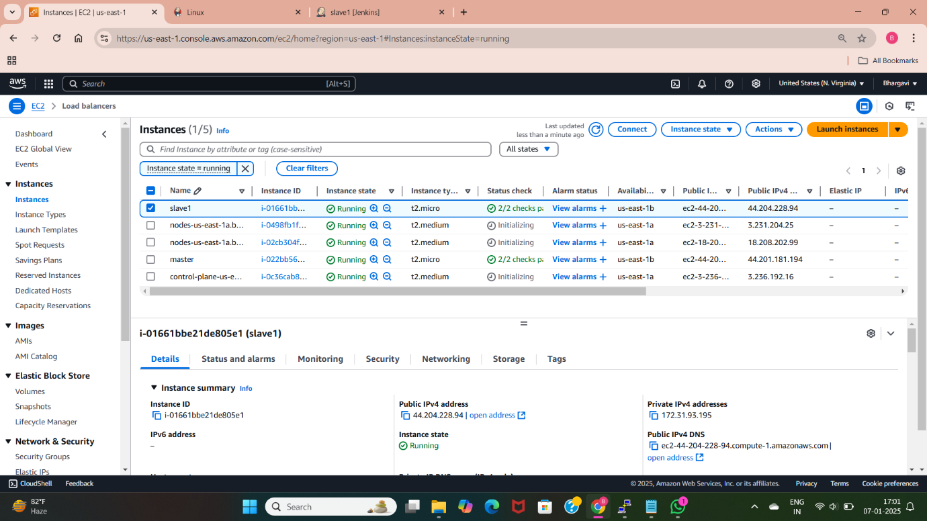
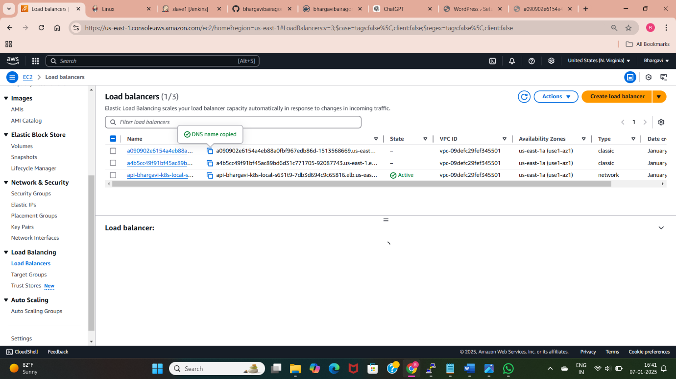
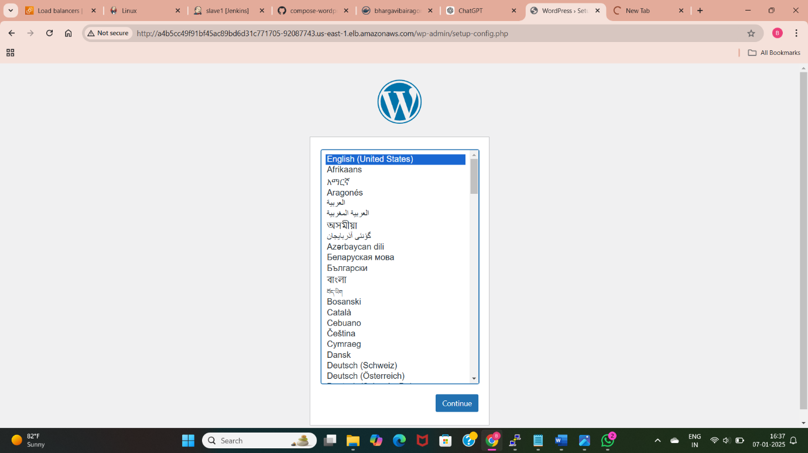

Slide 15
SLAve2
Docker is an open-source platform that allows developers to build, ship, and run applications inside lightweight, portable containers. It simplifies application deployment by packaging an application and its dependencies into a single container, ensuring that it works consistently across different environments.
Launch Slave2 Server in the Same AWS Account.
Create Slave2 Node.
Assign the Label to Slave2.
Install Docker and Docker Compose on Slave2.
Write Execution Commands for WordPress Deployment Using Docker Compose.
Execute the Docker Compose Deployment.
Verify Application Deployment.
Access Application via Public IP Address of Slave2 Instance .

Slide 16
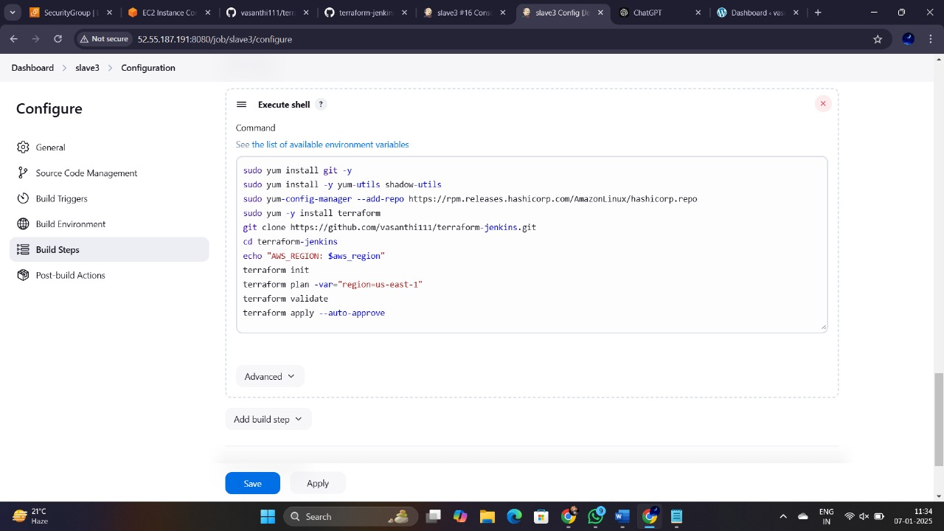
Slave3
Terraform is an open-source Infrastructure as Code (IaC) tool developed by HashiCorp. It allows users to define and provision infrastructure using a declarative configuration language. With Terraform, you can automate the creation, modification, and management of resources across various cloud providers, including AWS, Azure, and Google Cloud.
Launch Slave3 Server in the Same AWS Account.
Create Slave3 Node.
Assign the Label to Slave3.
Install Terraform on Slave3.
Write Execution Commands for WordPress Deployment Using Terraform.
Execute the Terraform Deployment.
Verify Application Deployment.
Access Application via Public IP Address of Slave3 Instance

Slide 17
Slave4
Build Periodically:
A configuration option in CI/CD tools (like Jenkins) to schedule builds at regular intervals using a cron-like syntax. Automates builds to run at specified times, regardless of whether changes have been made to the code repository.
Poll SCM:
A Jenkins feature where the tool checks the source code repository (e.g., GitHub, GitLab) for changes at regular intervals. Automatically triggers a build if changes are detected in the repository.
GitHub Webhook:
A mechanism to send real-time HTTP POST requests to a configured URL whenever a specific event occurs in a GitHub repository (e.g., push, pull request, or issue creation). Enables immediate communication between GitHub and external services (e.g., Jenkins) to trigger actions like builds without waiting for polling.

Slide 18
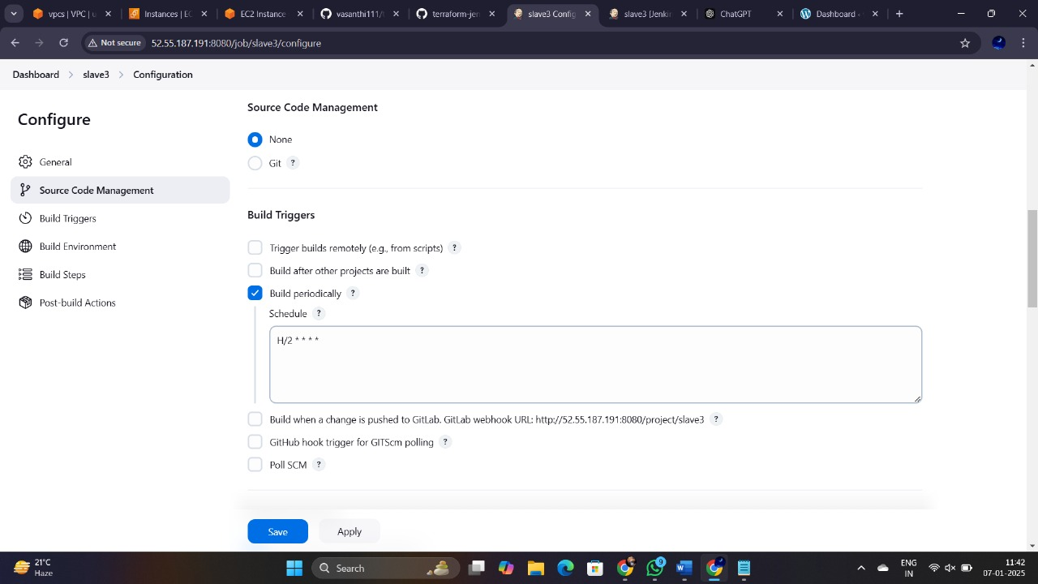
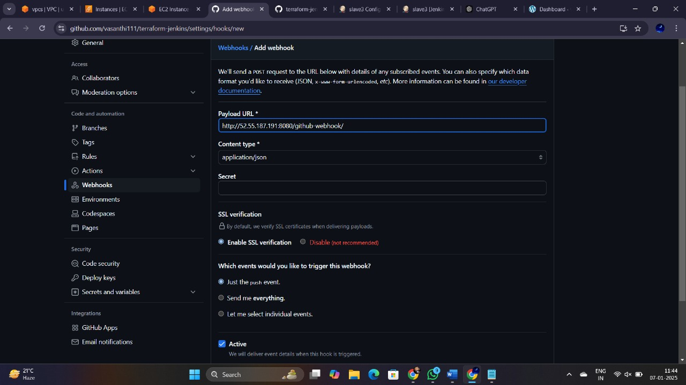
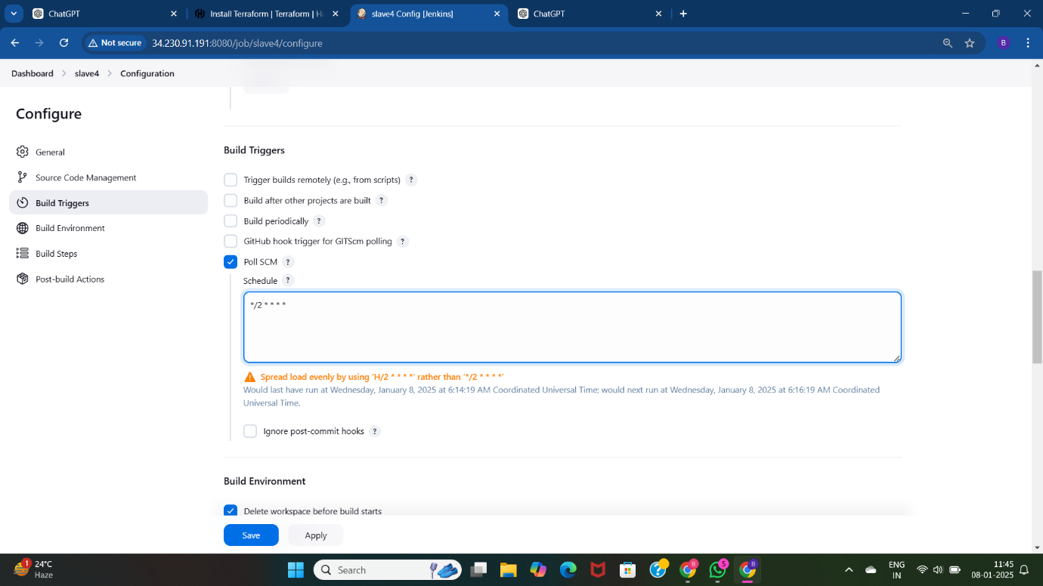
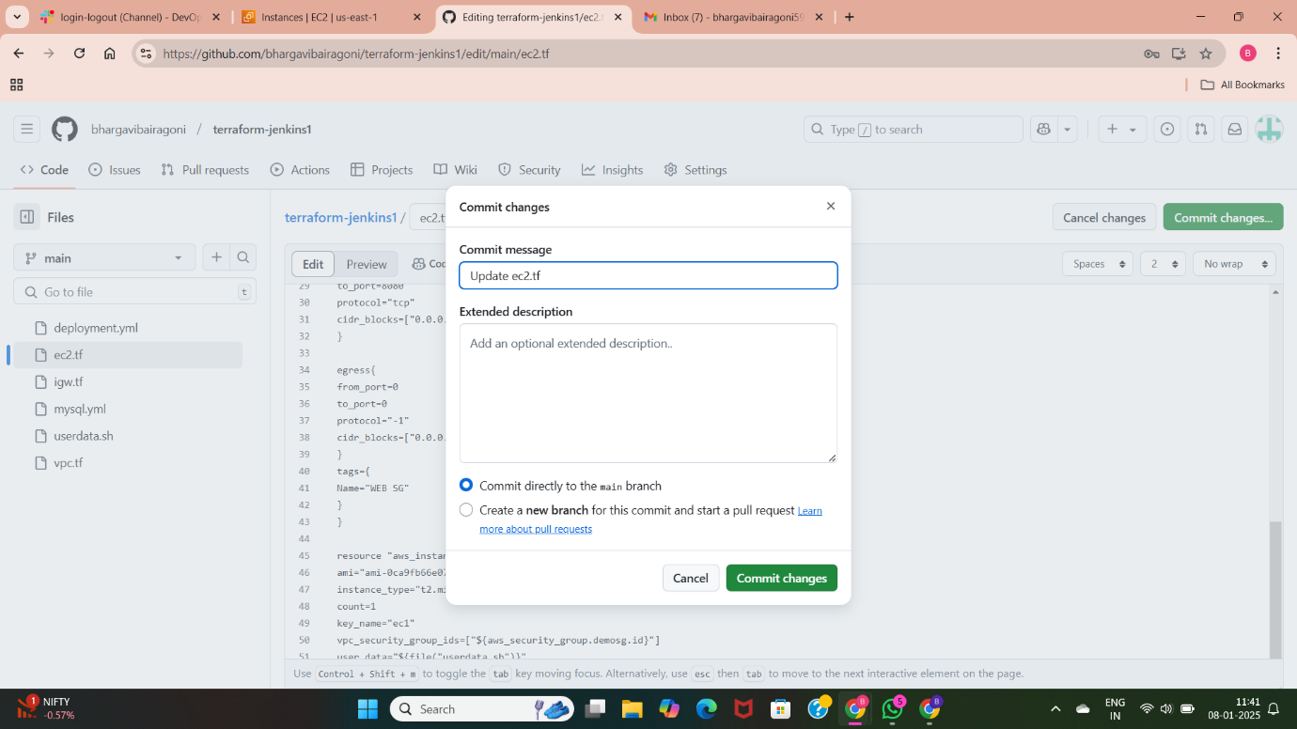

Slide 19
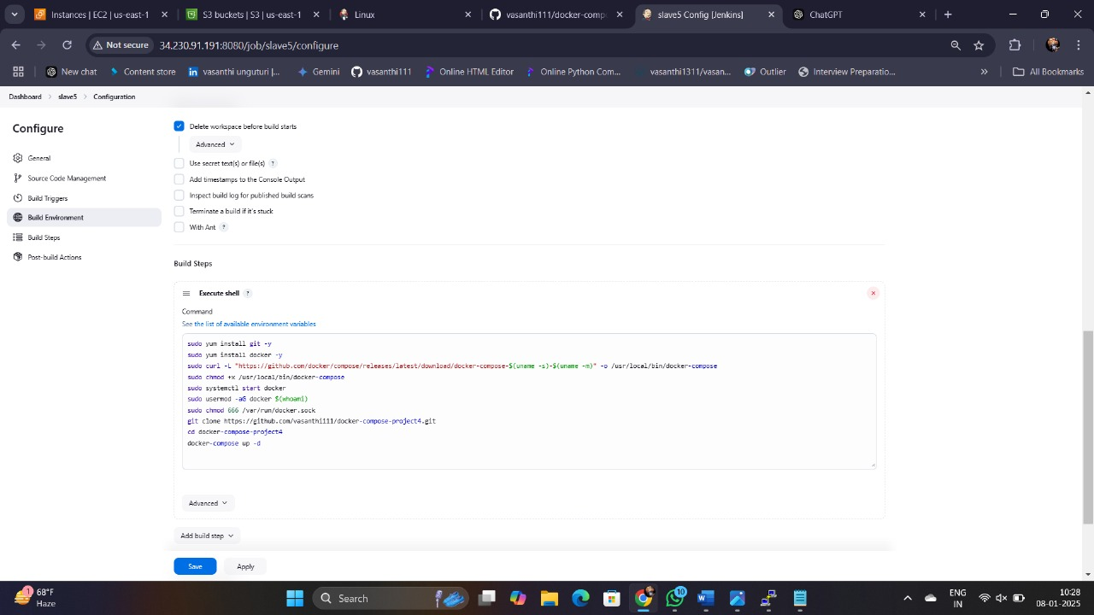
Slave5
Docker Compose is a tool provided by Docker to define and manage multi-container Docker applications. It simplifies running and orchestrating containers by using a YAML file(docker- compose.yml) to define the services, networks and volumes needed for your application.
Launch Slave5 Server in the Same AWS Account.
Create Slave5 Node.
Assign the Label to Slave5.
Install Bash Script for WordPress Deployment.
Write Execution Commands for WordPress Deployment Using Bash Script.
Execute the WordPress Deployment via Bash Script.
Verify Application Deployment.
Access Application via Public IP Address of Slave5 Instance

Slide 20
Thank you

